Slide 1
Communications Process

Slide 2
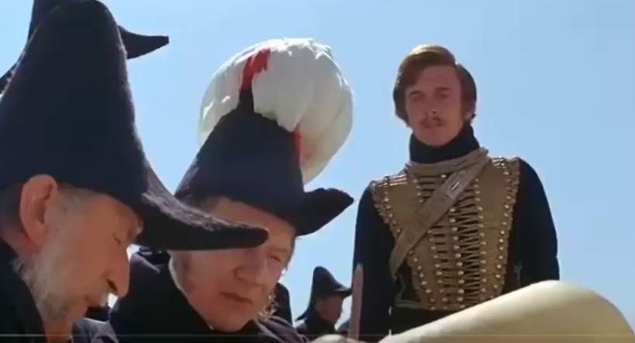
Charge of the Light Brigade Video
Charge of the Light Brigade

Slide 3
Learning Objectives
Understand the communication process
Identify barriers to effective communication
Describe ways to improve interpersonal communication

Slide 4
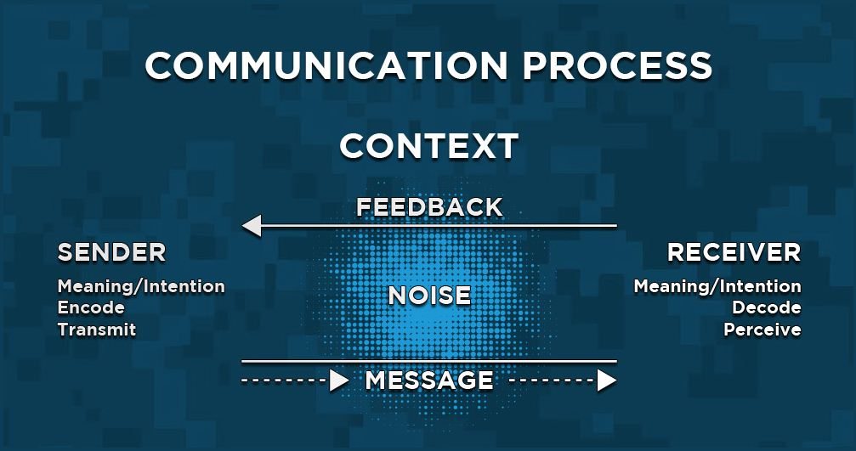
Communication Model

Slide 5
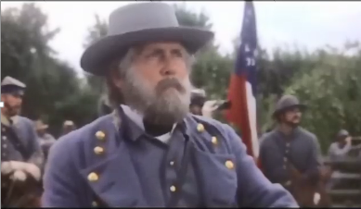
Lee's Intent (Gettysburg) Video
Lee's Intent (Gettysburg)

Slide 6
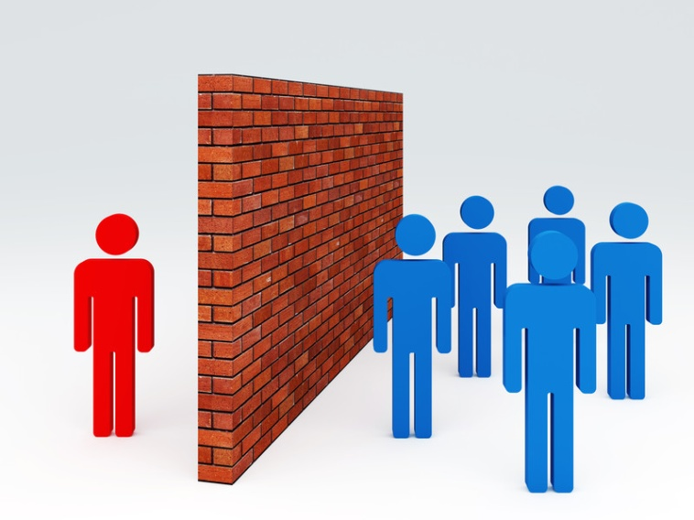
Communication Barriers
NOISE: Interference between the SENDER & RECEIVER
External Barriers: (Distractions)
Environmental
Visual
Physical
Internal Barriers: (Within)
Not Listening
Not Interested
Daydreaming
Semantic Barriers: (Different)
Languages
Educations
Cultures

Slide 7
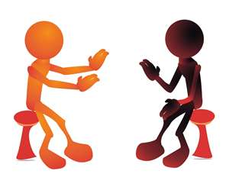
Improve Interpersonal Communication
Four Steps to Effective Interpersonal Communication:
Focus your message
Magnify the listener’s attention
Penetrate barriers
Listen actively

Slide 8
Closing
Review Learning Objectives:
Understand the communication process
Identify barriers to effective communication
Describe ways to improve interpersonal communication
Questions
Next Lesson:
CADET POST-CLASS ASSIGNMENT
Complete MS102L08 Communication Process LA.docx (Lesson Assessment); if assigned as homework, turn in next class
Complete writing program journal assignment (one paragraph); turn in next class

